Slide 1

Interactors

Slide 2
Interactors
Interactors: graphical element that the user can interact with or view
Presented by a GUI program
Also called widget

Slide 3
Interactors in graphics.py
Button - widget that the user can click to cause an action to take place
When creating a button can specify:
Text to appear on the face of the button
Location of the button
Text Field - widget that the user can type in
When creating a text field can specify:
Name of the text field
Text appear before the text field
Location of the text field

Slide 4
Interactors in graphics.py
Button
canvas.create_button(“Text and name of the button", location of the button)
e.g canvas.create_button(“Create Rectangle", Canvas.TOP)

Slide 5
Interactors in graphics.py
Text Field
canvas.create_text_field(“name and text of the textfield", location of the textfield)
e.g
canvas.create_text_field("Color", Canvas.TOP)

Slide 6
Artificial Intelligence
Slides by Chris Piech

Slide 7
A Little AI
http://cs.stanford.edu/people/karpathy/convnetjs/demo/rldemo.html

Slide 8
What is AI?

Slide 9
[suspense]

Slide 10
AI: The study and design of intelligent agents

Slide 11
Computer
programs
AI: The study and design of intelligent agents
Better than
chance
As well as
humans

Slide 12
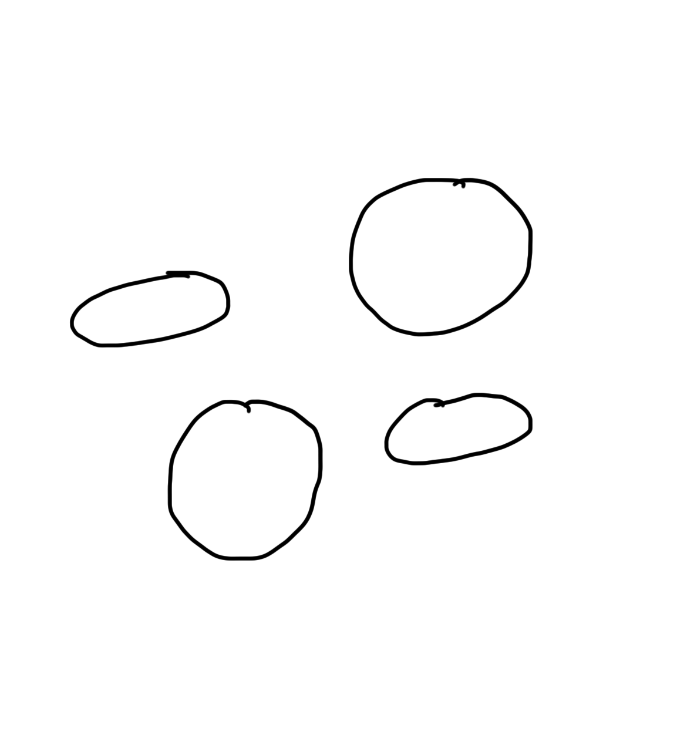
Narrow Intelligence
Translate
Turkish or Czech
Play Chess
Play Breakout
Drive a
Car

Slide 13
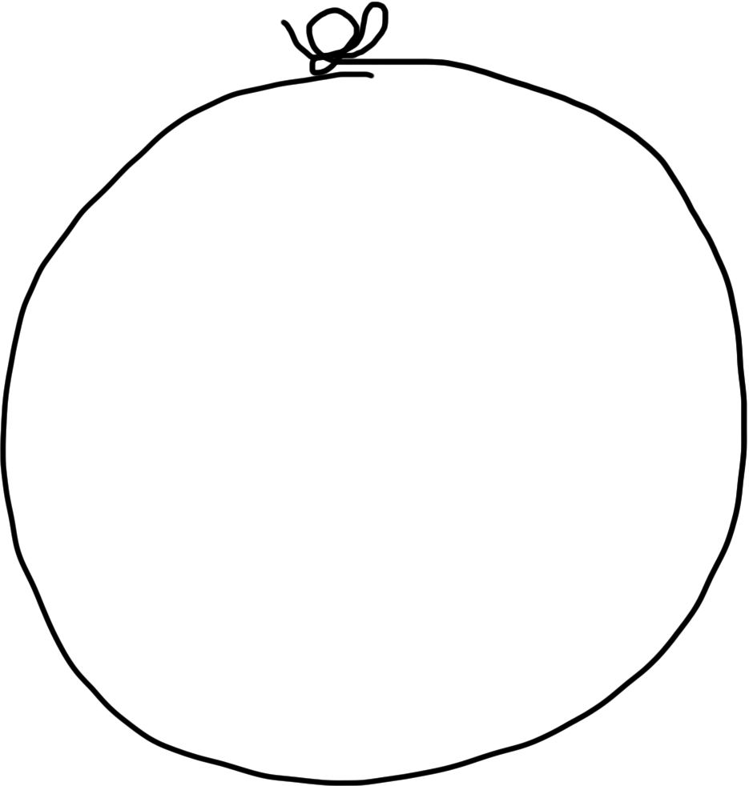
General Intelligence
Translate
Turkish
Play Chess
Play Breakout
Drive a
Car

Slide 14

Big Milestones

Slide 15
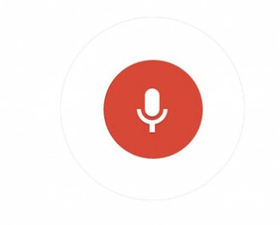
Told Speech Was 30 Years Out
Almost perfect…

Slide 16
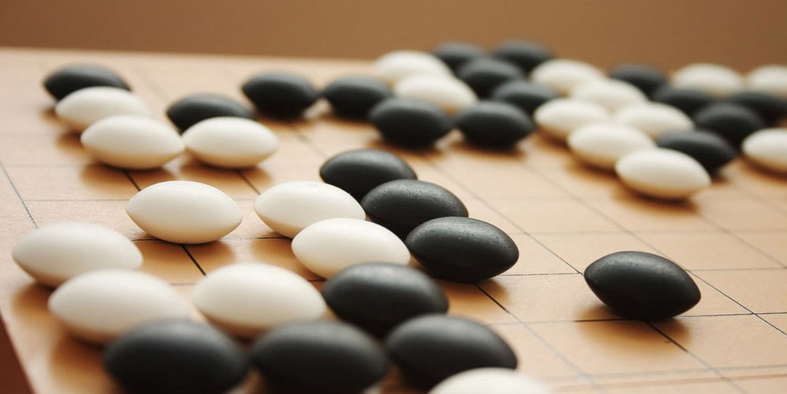
The Last Remaining Board Game

Slide 17
Computers Making Art

Slide 18
Self Driving Cars

Slide 19
Make a Harry Potter Sorting Hat

Slide 20

Classification
Logistic Regression is like the Harry Pottery Sorting Hat
That is a picture
of a one

Slide 21

Classification
Logistic Regression is like the Harry Pottery Sorting Hat
That is a picture
of a zero

Slide 22

Classification
That is a picture
of an zero
* It doesn’t have to be correct all of the time

Slide 23
Can you do it?

Slide 24


Slide 25


Slide 26

How about now?
What a computer sees
0 | 0 | 1 | 0 | 1 | 0 | 1 | 0 | 0 | 0 | 1 | 1 | 1 | 0 | 1
1 | 0 | 0 | 1 | 0 | 1 | 1 | 1 | 0 | 1 | 0 | 0 | 0 | 0 | 0
1 | 1 | 1 | 0 | 1 | 0 | 0 | 1 | 1 | 0 | 0 | 1 | 0 | 1 | 0
1 | 1 | 1 | 1 | 1 | 0 | 0 | 0 | 0 | 0 | 1 | 1 | 0 | 1 | 1
0 | 0 | 0 | 1 | 1 | 0 | 0 | 1 | 0 | 0 | 0 | 1 | 1 | 1 | 0
1 | 0 | 0 | 1 | 1 | 0 | 0 | 0 | 1 | 0 | 1 | 1 | 1 | 1 | 0
1 | 1 | 0 | 1 | 1 | 0 | 0 | 1 | 1 | 0 | 1 | 1 | 1 | 0 | 0
1 | 0 | 1 | 0 | 0 | 1 | 0 | 0 | 1 | 0 | 0 | 1 | 1 | 1 | 1
0 | 0 | 0 | 0 | 1 | 0 | 1 | 0 | 1 | 1 | 0 | 0 | 1 | 1 | 1
0 | 1 | 1 | 0 | 0 | 0 | 0 | 0 | 1 | 1 | 1 | 1 | 1 | 1 | 0
0 | 0 | 1 | 0 | 1 | 1 | 1 | 0 | 0 | 0 | 1 | 0 | 0 | 0 | 0
0 | 1 | 1 | 1 | 0 | 1 | 0 | 0 | 1 | 0 | 0 | 0 | 0 | 0 | 1
1 | 1 | 0 | 0 | 0 | 0 | 0 | 0 | 0 | 0 | 1 | 0 | 0 | 1 | 1
0 | 0 | 0 | 0 | 0 | 0 | 0 | 0 | 1 | 1 | 1 | 1 | 0 | 0 | 1
0 | 0 | 1 | 1 | 1 | 0 | 1 | 0 | 1 | 1 | 0 | 0 | 0 | 1 | 0
What a human sees

Slide 27
Why is it easy for Humans?
About 30% of your cortex is used for vision
3% is used to process hearing

Slide 28
Very hard to Program
??
def main():
print(“Todo: Write program”)

Slide 29
Perhaps there is an insight?

Slide 30
Two Great Ideas
1. Artificial Neurons
2. Learn by Example

Slide 31
Two Great Ideas
1. Artificial Neurons
2. Learn by Example

Slide 32
1. Artificial Neurons

Slide 33
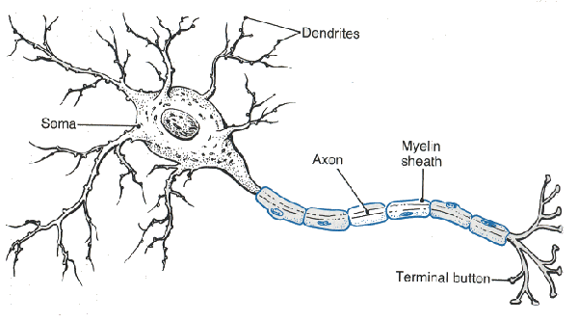
Neuron

Slide 34
Artificial Neuron

Slide 35
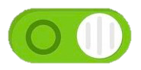



Inputs
+

Slide 36
Weights
+

Slide 37
Weighted Sum
+
weightedSum = 0
weightedSum = weightedSum + input0 * weight0
weightedSum = weightedSum + input1 * weight1
weightedSum = weightedSum + input2 * weight2
weightedSum = weightedSum + input3 * weight3

Slide 38
Weighted Sum
+
weightedSum = 0
for i in range(4):
weightedSum += weight[i] * input[i]

Slide 39
Filter and Output
+

Slide 40
Put Many Together
+
+
+
+

Slide 41
Making a Prediction
Input Neurons
Hidden Neurons
Output Neurons
…

Slide 42
Making a Prediction
Input Neurons
Hidden Neurons
Output Neurons
…

Slide 43
Making a Prediction
Input Neurons
Hidden Neurons
Output Neurons
…

Slide 44
Making a Prediction
Input Neurons
Hidden Neurons
Output Neurons
I think that is a picture of a one!
…

Slide 45
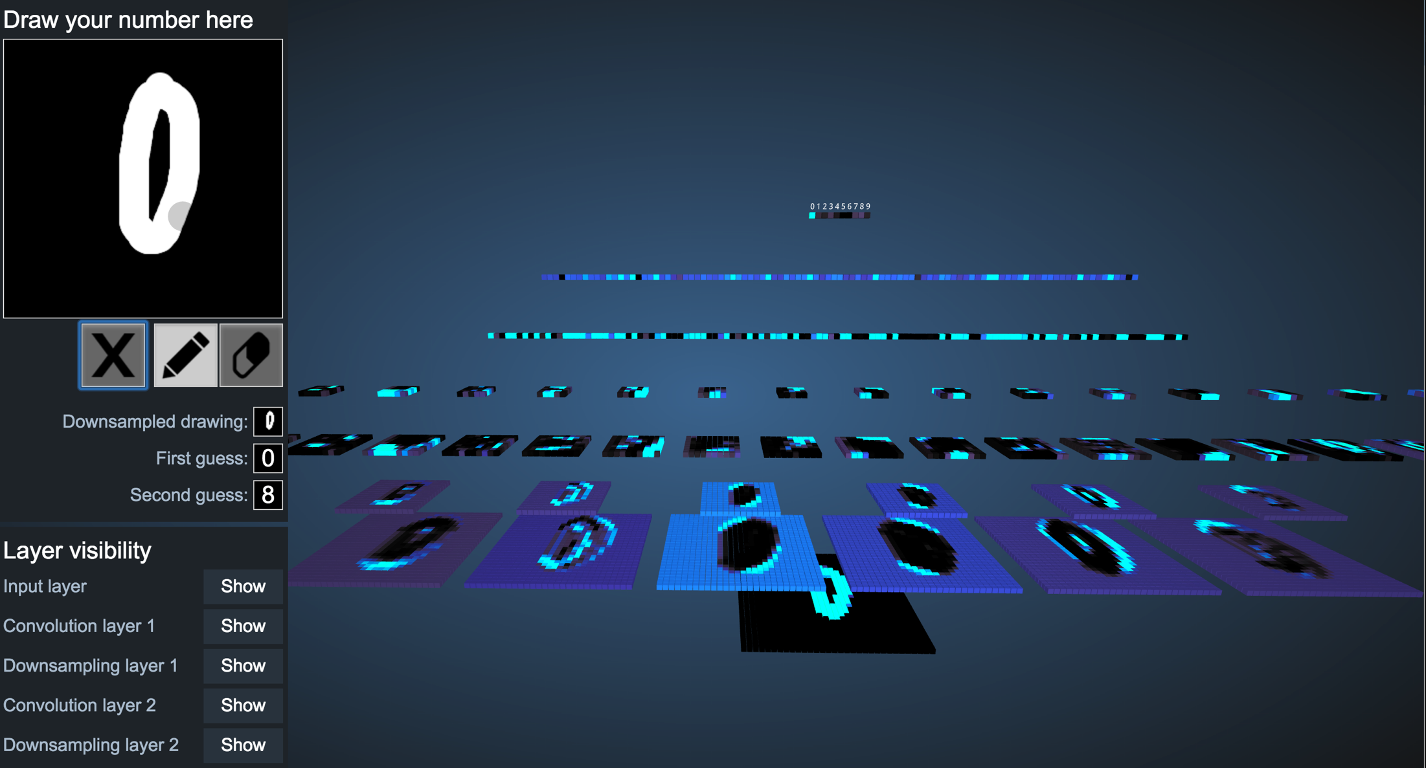
Demonstration
http://scs.ryerson.ca/~aharley/vis/conv/

Slide 46
Great Idea: Artificial Neurons

Slide 47
Neural Networks get their intelligence from their sliders (parameters)

Slide 48
Two Great Ideas
1. Artificial Neurons
2. Learn by Example

Slide 49
Two Great Ideas
1. Artificial Neurons
2. Learn by Example

Slide 50
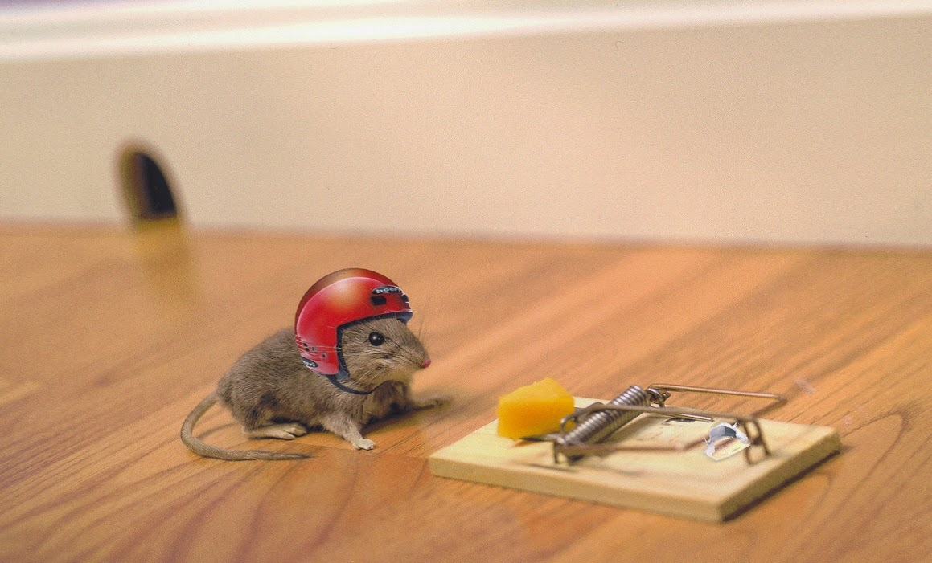
2. Learn From Experience

Slide 51

Learn by Example

Slide 52
+

Slide 53
+

Slide 54
I think that is a picture of a One!
+
What do you mean it’s actually a Zero?
I’ll adjust my sliders so that I do a better job in the future

Slide 55
I think that is a picture of a One!
+
What do you mean it’s actually a Zero?
I’ll adjust my sliders so that I do a better job in the future

Slide 56
+

Slide 57
+

Slide 58
+

Slide 59
I think that is a picture of a One!
+
Wahoo I got it right!

Slide 60
+

Slide 61
+

Slide 62
I think that is a picture of a zero!
+
What do you mean it’s actually a one?
I’ll adjust my sliders so that I do a better job in the future

Slide 63
I think that is a picture of a zero!
+
What do you mean it’s actually a one?
I’ll adjust my sliders so that I do a better job in the future

Slide 64
Study Hard!

Slide 65
Train on Faces

Slide 66
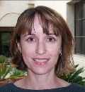
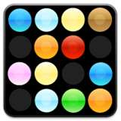
Visualize the Sliders
object models
object parts
(combination
of edges)
Training set: Aligned
images of faces.
edges
pixels
[Honglak Lee]

Slide 67
Woah… that’s like a brain…

Slide 68
True.

Slide 69
0.005%
1.5%
66.3%
Random guess
Pre Neural Networks
2016
http://image-net.org/challenges/LSVRC/2016/results

Slide 71

Google Brain

Slide 72
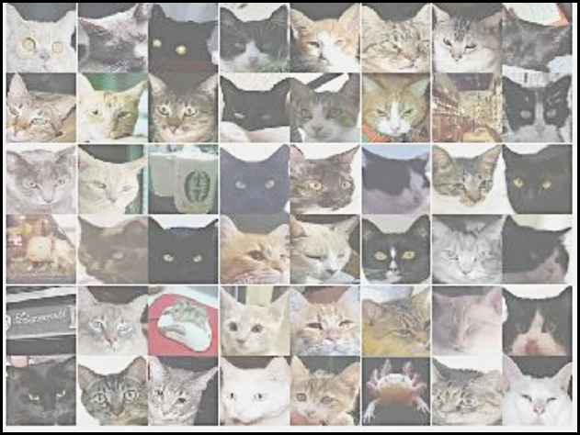
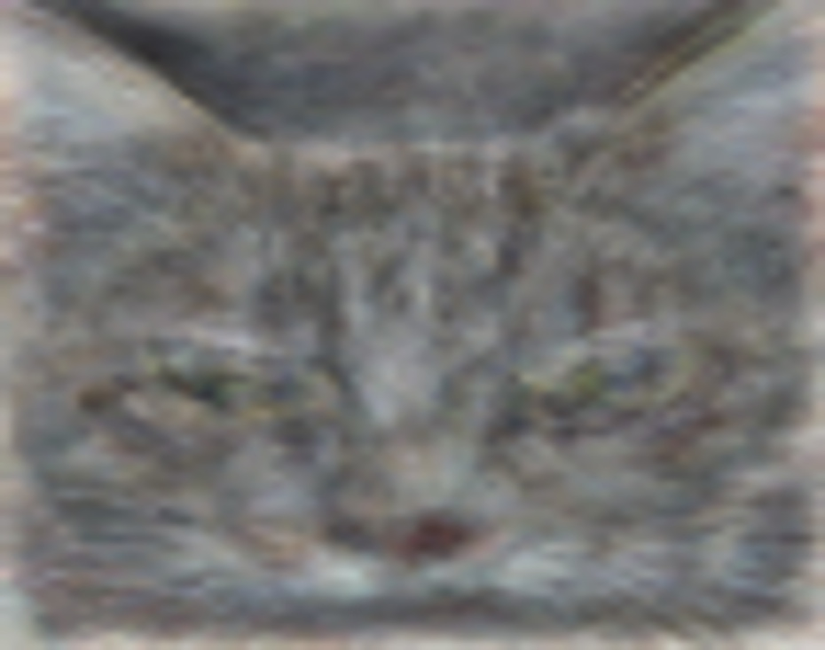
A Neuron That Fires When It Sees Cats
Top stimuli from the test set
Optimal stimulus
by numerical optimization
Le, et al., Building high-level features using large-scale unsupervised learning. ICML 2012

Slide 74
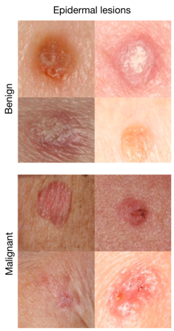
It can be useful
An algorithm learned to detect skin cancer from photo, better than the worlds top expert.
Developed last year
Esteva, Andre, et al. "Dermatologist-level classification of skin cancer with deep neural networks." Nature 542.7639 (2017): 115-118.
Esteva et al., Nature 2017.

Slide 75
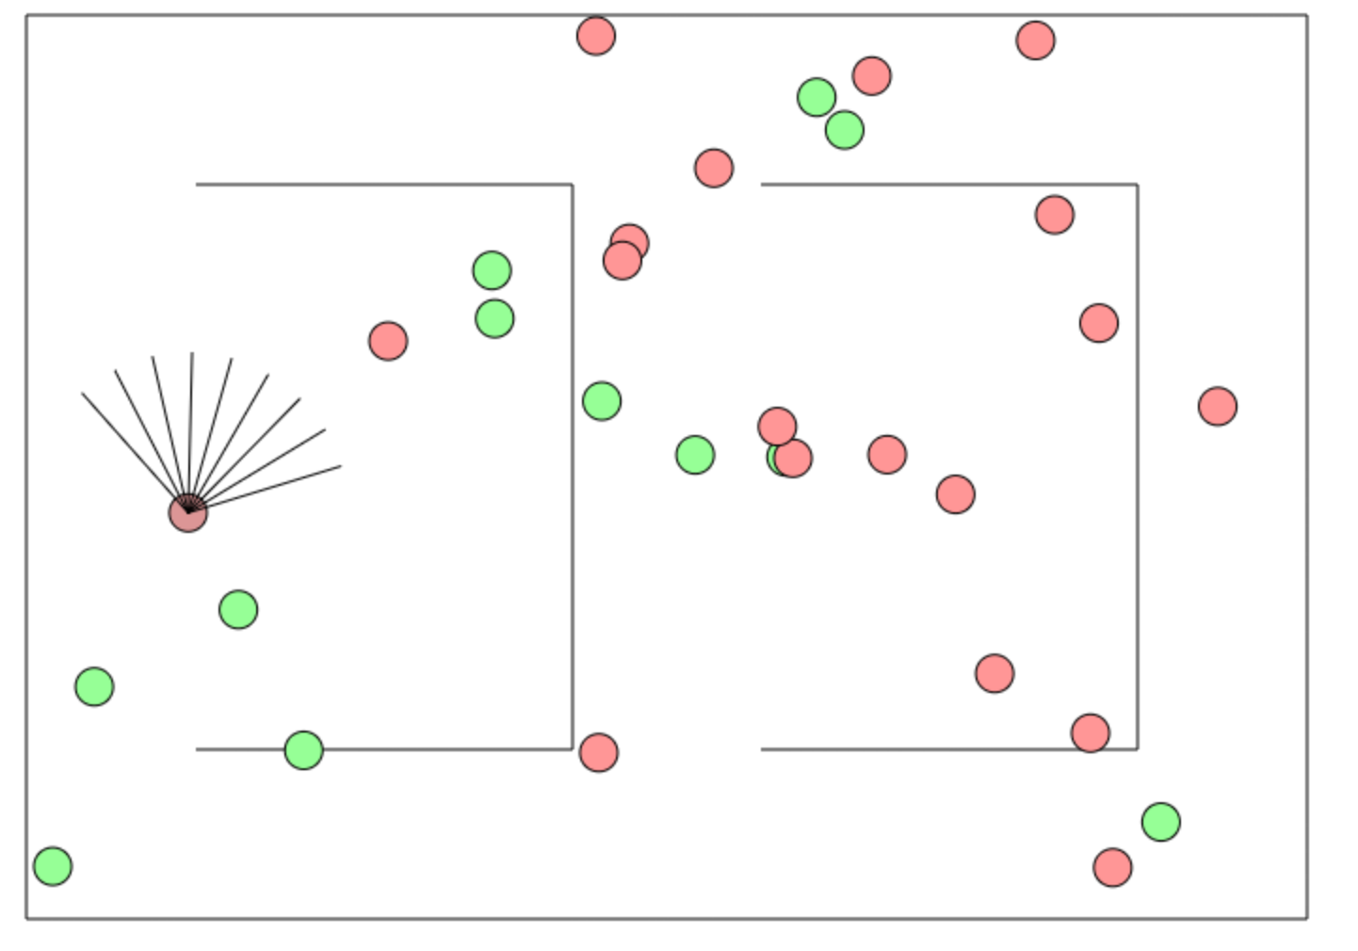
Beyond Harry Potter Hats
http://cs.stanford.edu/people/karpathy/convnetjs/demo/rldemo.html

Slide 76
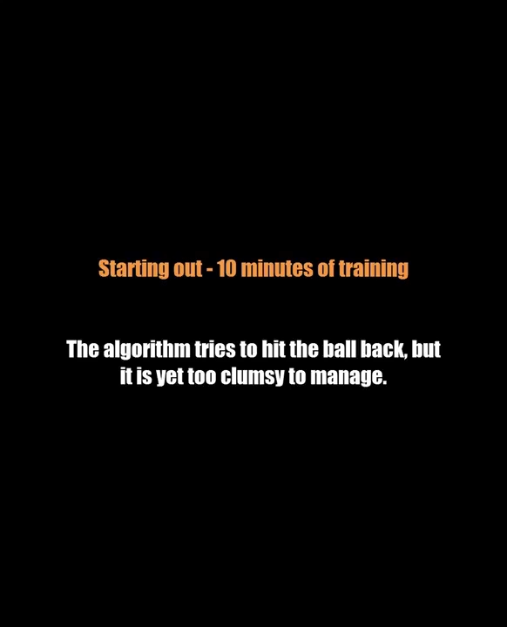
Beyond Classification

Slide 77
The Future of AI
Human Intelligence
Performance
Complex Programs
Neural Networks
Time
Now
2012
Notes:
NVIDIA or ATI will be future of AI. Probably NVIDIA.

Slide 78
The Future of AI
Human Intelligence
Performance
Complex Programs
Neural Networks
Time
Now
2012
Notes:
NVIDIA or ATI will be future of AI. Probably NVIDIA.

Slide 79
The Future of AI
Human Intelligence
Performance
Complex Programs
Neural Networks
Time
Now
2012
Notes:
NVIDIA or ATI will be future of AI. Probably NVIDIA.

Slide 80
Where is my robot?

Slide 81
… coming soon

Slide 82
Should I study AI?

Slide 83

Powerful technology

Slide 84
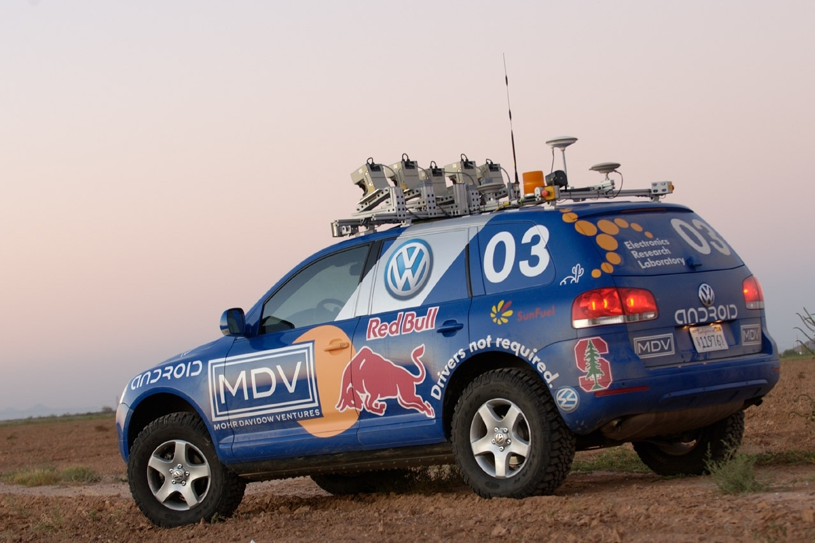
Now is an amazing time

Slide 85
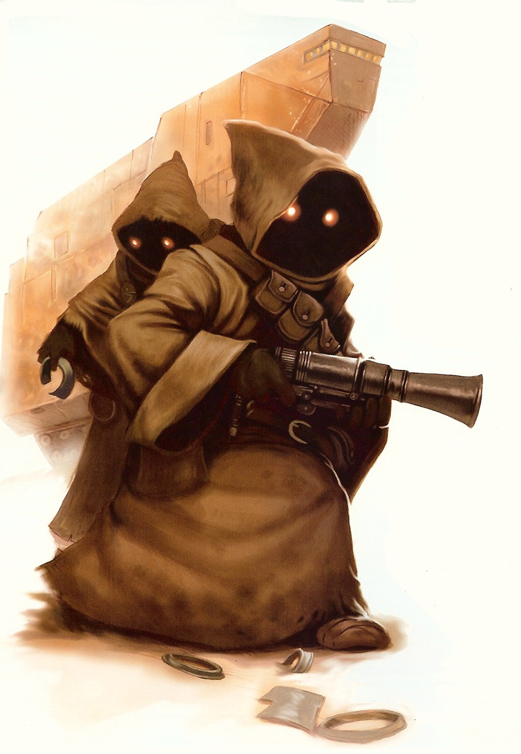
Know It So You Can Beat It
Little math

Slide 86
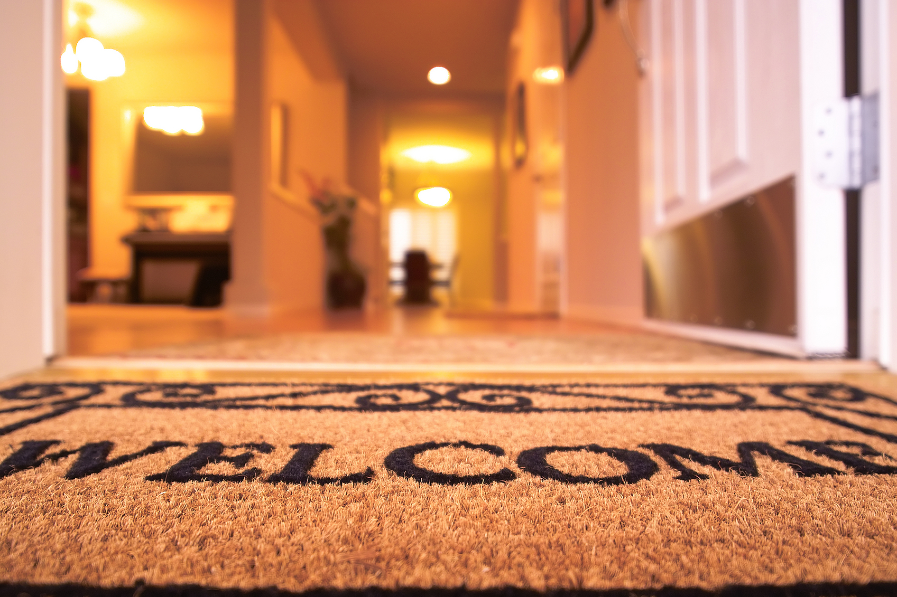
Todos son bienvenidos

Slide 87
Road towards AI
Libraries to use AI
Mathematics to invent AI

Slide 88
Next Step:
…

Slide 89
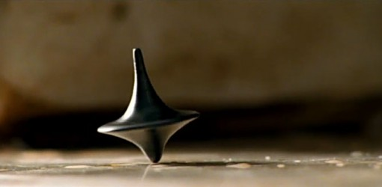
The End?

